Slide 1
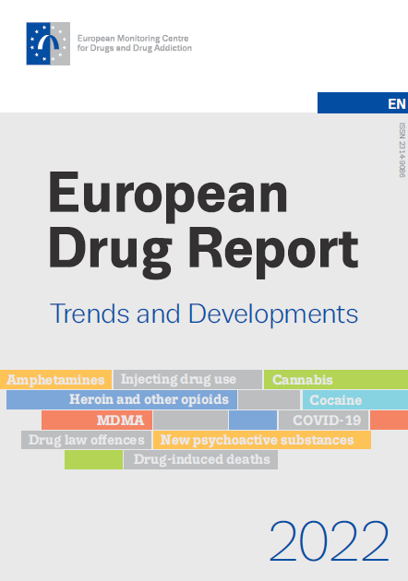
14 June 2022
10.00 Lisbon | 11.00 Brussels

Slide 2
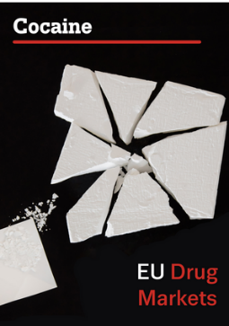
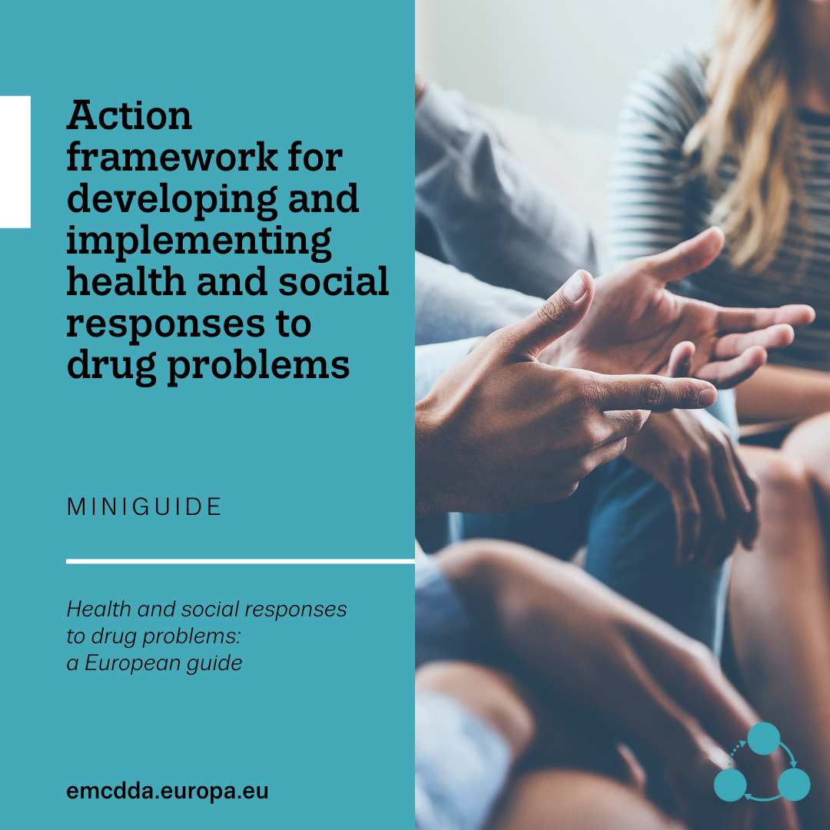
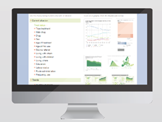
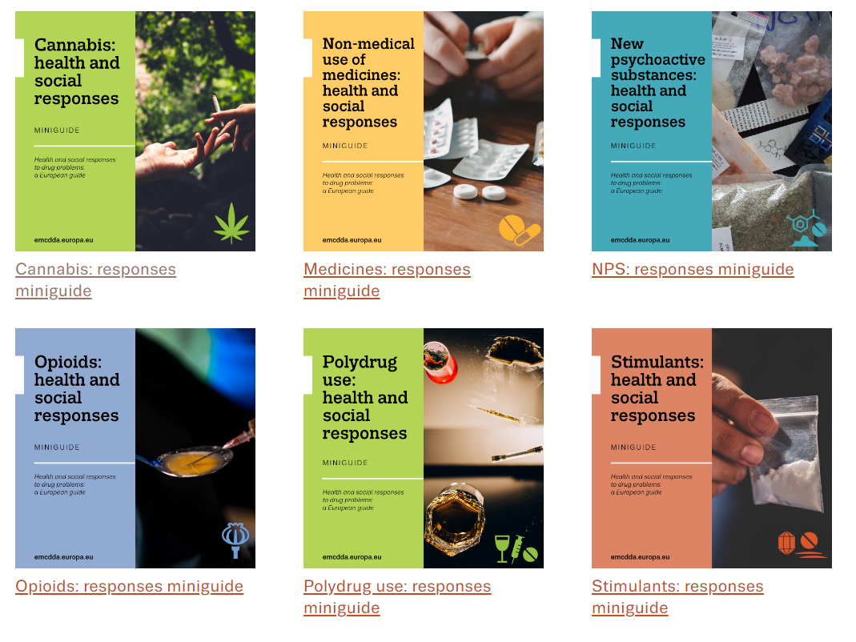
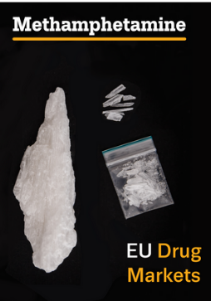
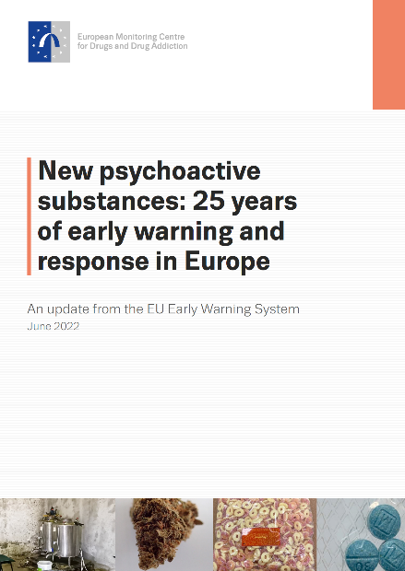
European Drug Report 2022

Slide 3

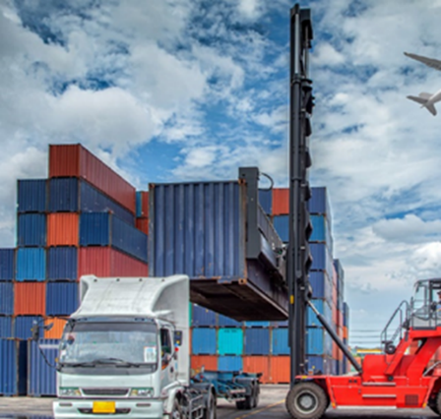
EDR 2022: drug supply and use bounce back after COVID-19 disruption

Slide 4


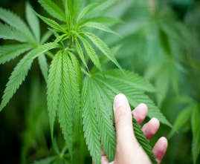
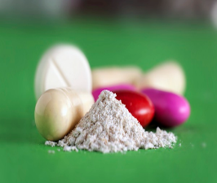

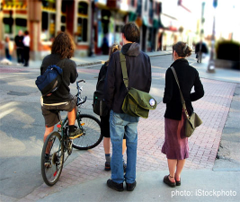
EDR 2022: Europe’s drug problems have become more complex
Today, drug-related issues appear almost everywhere
Almost everything with psychoactive potential can be a drug
Everyone can be affected, whether directly or indirectly

Slide 5
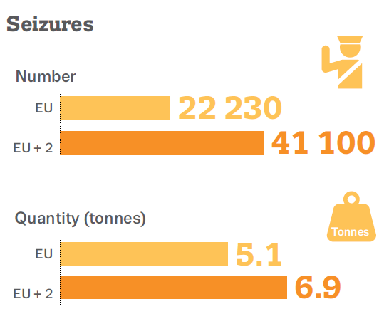
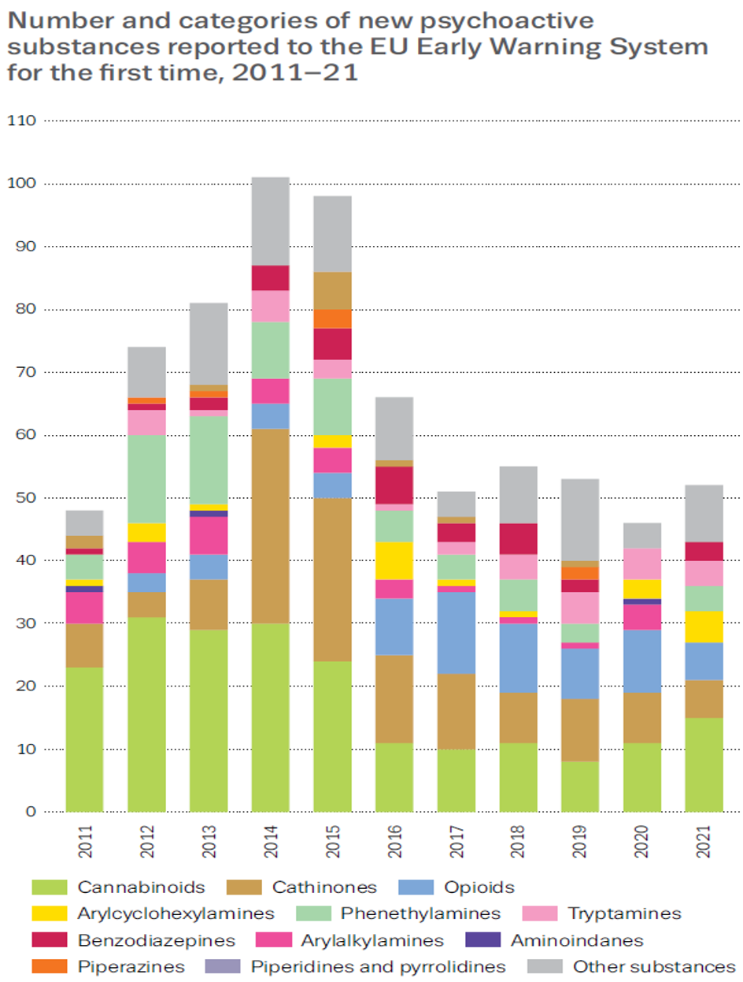
NPS: potentially harmful substances continue to appear
Synthetic cathinones: large-scale seizures in 2020, trafficked from India
2021 risk-assessments: 3-MMC and 3-CMC
15 new synthetic cannabinoids detected in 2021

Slide 6
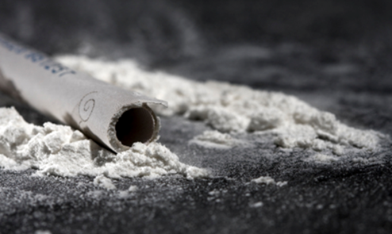
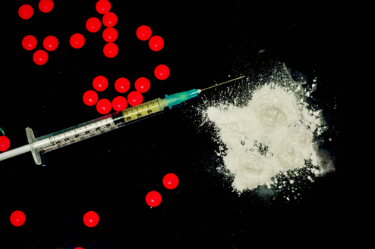
Cathinones: record trafficking to Europe, health harms prompt new controls
Synthetic cathinones: EU EWS monitors 162
Seizures: 3.3 tonnes in 2020 (0.75 tonnes in 2019)
Most bulk quantities originated in India, mainly N-ethylhexedrone, 3-MMC and 3-CMC
Harms: 3-MMC suspected poisonings rose in Netherlands: 10 in 2018 to 64 in 2020. Cathinone injecting linked to high-risk sexual practices and HIV and HCV outbreaks
Risk assessments: 3-MMC and 3-CMC risk assessed in 2021

Slide 7
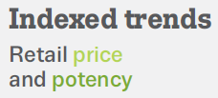
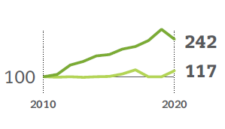
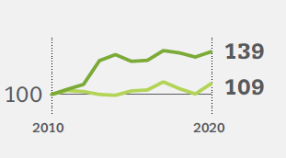
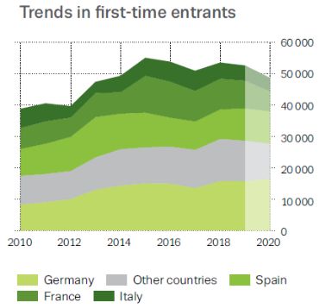
Cannabis: new developments for Europe’s most popular illicit drug
15.5 % of 15-34 year olds used cannabis in the last year
Resin’s average THC content now twice herb’s: 21 % vs. 11 %
Cannabis is responsible for 45 % of all first-time treatment entries
Cannabis products: extracts and edibles (high THC content), CBD products (low THC content)
Concern about reports of adulteration with synthetic cannabinoids, which can be highly potent and toxic
Cannabis resin
Cannabis herb

Slide 8
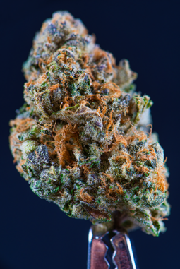
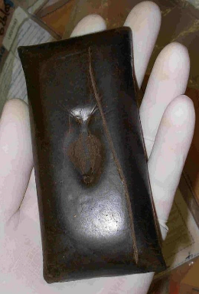
Cannabis policy: increasingly complex in Europe
Cannabis policies now encompass:
control of illicit cannabis
regulation of cannabis for medical uses
other emerging uses and forms, including as ingredients in some commercial products
Regulatory status: some EU MS debating adjustments to the status of cannabis
Medical use of cannabis: allowed by most EU MS
Growing complexity in cannabis-based products traded in the EU: more registrations of cannabis plant varieties, product trademarks, hectares of hemp grown and applications for novel food products, shops selling low-THC cannabis products

Slide 9
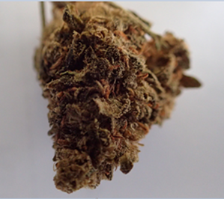
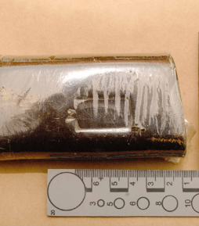

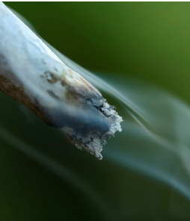
Cannabis: concern about adulteration with synthetic cannabinoids
Increase in samples containing ADB-BUTINACA in 2021
Purchased as illegal cannabis: people unaware what products contained
Health risks: more intense intoxication, mental, physical and behavioural effects than cannabis, some fatal and non-fatal poisoning reported

Slide 10
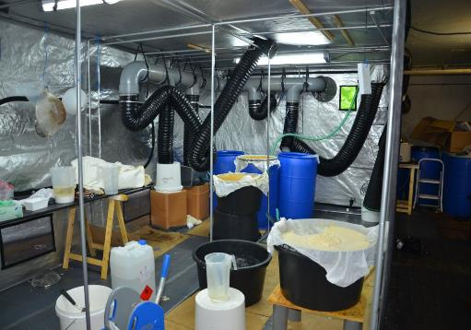
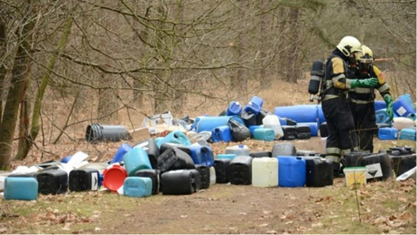
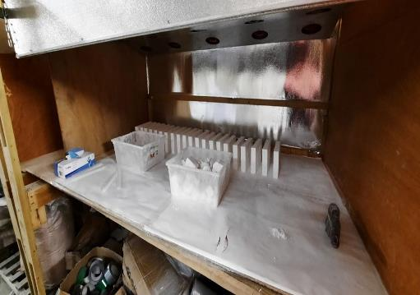
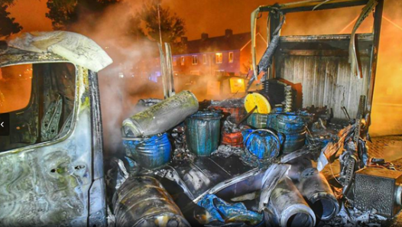
EDR 2022: drug production continues to increase in Europe
2020: over 350 laboratories dismantled Heroin Cocaine
Amphetamine Methamphetamine
MDMA Cathinones
Ketamine GHB
DMT

Slide 11
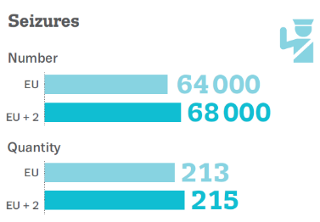


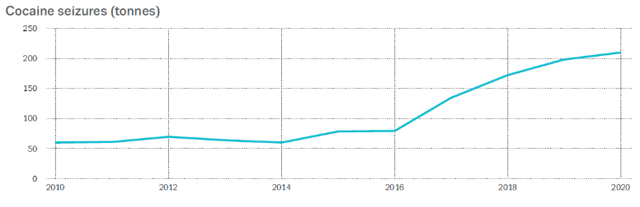
Cocaine: record cocaine seizures highlight threats to health

Slide 12
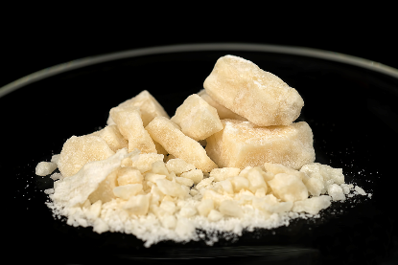
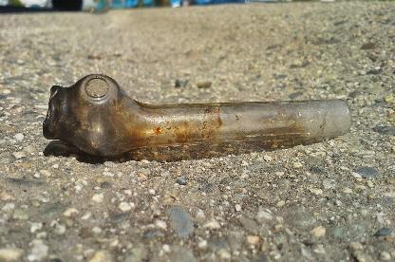
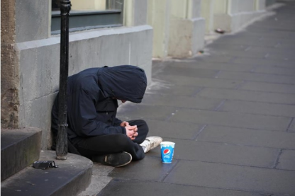
Crack cocaine: signs of use spreading among vulnerable groups
Drivers: high availability of cocaine, economic deprivation and small, cheap crack doses
Crack use: mostly in vulnerable and marginalised groups
Treatment: an estimated 7 000 clients in 2020
Harms: high-frequency use linked to mental and physical health and social problems
Injecting cocaine associated with elevated risk of HIV and HCV infection

Slide 13
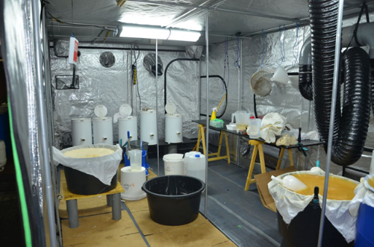
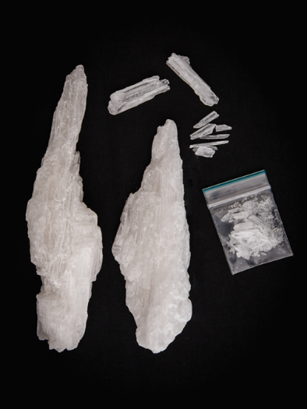
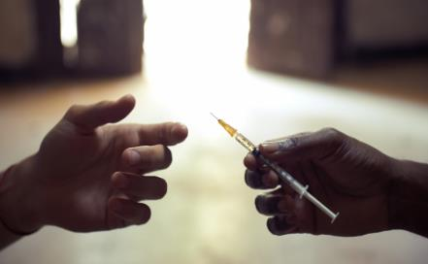
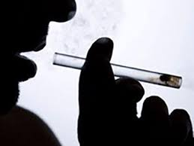
Methamphetamine: changed production and supply dynamics raise risk of increased use
Production: large-scale sites now detected; collaboration between European and Mexican criminals
Europe’s role: large quantities produced for global export
Consumption in Europe: still low, but potential to grow with diffusion of use to more continues
Harms: acute toxicity, psychotic episodes, polydrug use, blood-borne viruses from injecting and death

Slide 14

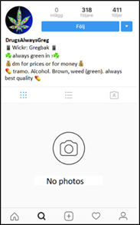

Darknet drug markets: signs of decline
Digitally enabled drug markets: darknet markets, social media and instant messaging apps
Darknet markets impacted by: COVID-19 pandemic, law-enforcement activity, scams, delivery problems and long periods of downtime
Declining revenues: EUR 30 000 per day in 2021 (down from EUR 1 million per day in 2020)
Other technology: sales using social media and instant messaging apps gaining interest

Slide 15
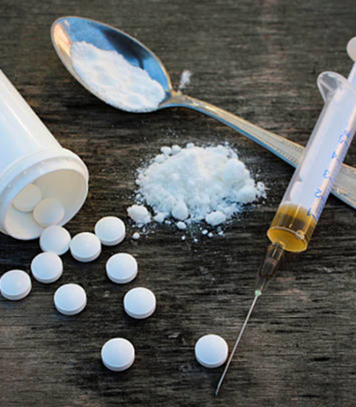
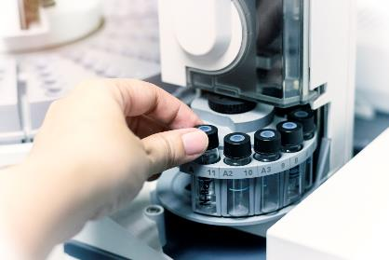
Injecting drug use: declining, but still a concern
Injecting: 22 % of first-time treatment clients with heroin as their primary drug reported injecting as main route of use in 2020 (35 % in 2013)
Drugs injected appear more diverse: opioids, heroin, also amphetamines, cocaine, synthetic cathinones, prescribed opioid medications and other medicines
Syringe residue analysis: out of 1 392 used syringes collected in 2020-21 in 5 cities, half or more contained stimulants, a third contained two or more drugs

Slide 16

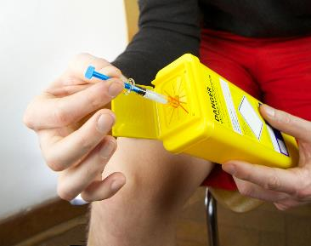
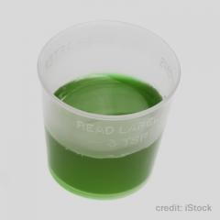
Treatment and harm reduction: services still need to be scaled-up
WHO targets: only four reporting countries in 2020 distributed 200 syringes per person who injects and had 40 % of the population of high-risk opioid users in opioid agonist treatment
Prevalence of high-risk opioid use: estimated at 0.34 % for the EU adult population, equivalent to around 1 million high-risk opioid users in 2020
Opioid agonist treatment: 514 000 clients in 2020
Considerable access differences exist between countries.

Slide 17
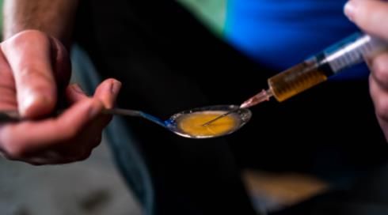

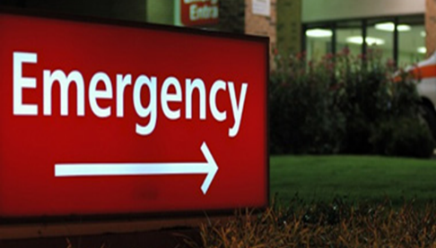
Drug-induced deaths: driven by opioids and other drugs
Overdose deaths: an estimated 5 800 in EU in 2020
Mortality rate: 16.7 deaths per million
Polydrug toxicity: illicit opioids, other illicit drugs, medicines and alcohol
Benzodiazepines: common in drug-induced-death toxicological reports in some countries
Opioids: present in around three quarters of all drug-induced deaths

Slide 18
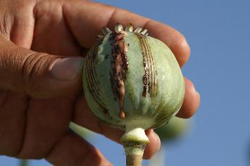
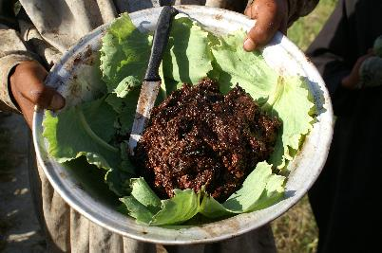
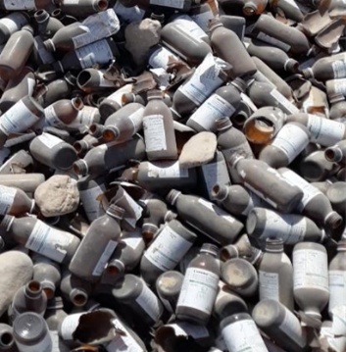
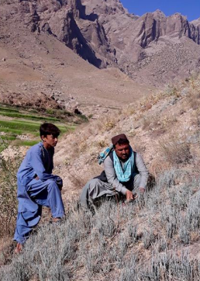
Developments in Afghanistan: implications for European drug markets
Production: world’s largest producer of illicit opium and heroin, large-scale ephedra-based methamphetamine production also now detected
Economic and humanitarian crisis: could increase drug cultivation, production and trafficking to Europe
Cultivation bans: hard to enforce
Seizures: record amounts of methamphetamine seized on main heroin trafficking routes towards Europe
Future developments currently unclear but require monitoring

Slide 19
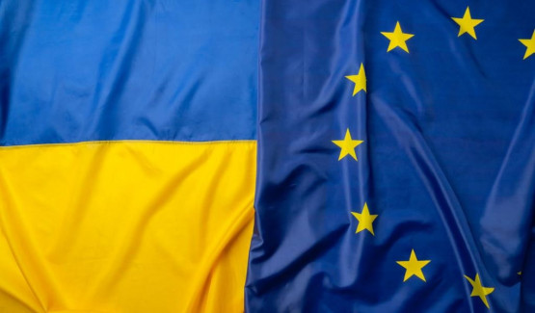
War in Ukraine: increases uncertainty of Europe’s drug situation
Russia’s invasion: triggered a major humanitarian crisis with ongoing implications
Too soon to assess impact: drug markets, drug use or the provision of services for those with drug problems
Priority needs: continuity of treatment, language services and the provision of accommodation and social welfare support

Slide 20
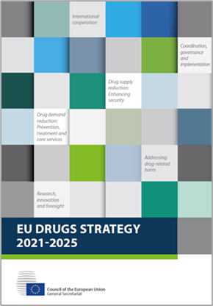
EDR 2022: concluding remarks
Drug supply and use bounced back after COVID-19 disruption
Digitalisation of drug markets may have accelerated
Innovation driving high availability and greater diversity of substances: increased synthetic drug production, large seizures and new trafficking routes
Today, drugs are everywhere, almost everything can be a drug, everyone can be affected, whether directly or indirectly
Humanitarian crisis in Afghanistan and Ukraine also has the potential to impact on Europe’s drug problems
EU Drugs Strategy and Action Plan (2021-25) provides a key framework for coordinated action

Slide 21
emcdda.europa.eu/edr2022
#EuropeanDrugReport2022 #HealthierEurope #MoreSecureEurope

